Slide 1
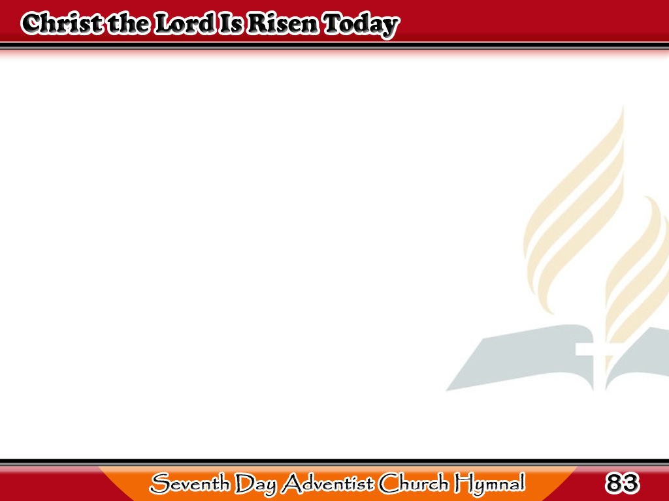
Si Cristo ay nabuhay
Christ the Lord is
risen today, Alleluia!
Sons of men and
angels say, Alleluia!
1/4

Slide 2
Si Cristo ay nabuhay
Raise your joys
and triumphs high, Alleluia!
Sing, ye heavens,
and earth reply, Alleluia!
1/4

Slide 3
Si Cristo ay nabuhay
Lives again our
glorious King, Alleluia!
Where, O death,
is now thy sting? Alleluia!
2/4

Slide 4
Si Cristo ay nabuhay
Once He died,
our souls to save, Alleluia!
Where’s thy victory,
boasting grave?Alleluia!
2/4

Slide 5
Si Cristo ay nabuhay
Love’s redeeming
work is done, Alleluia!
Fought the fight,
the battle won, Alleluia!
3/4

Slide 6
Si Cristo ay nabuhay
Death in vain
forbids Him rise, Alleluia!
Christ hath
opened Paradise, Alleluia!
3/4

Slide 7
Si Cristo ay nabuhay
Soar we then where
Christ has led, Alleluia!
Following our
exalted Head, Alleluia!
4/4

Slide 8
Si Cristo ay nabuhay
Made like Him,
like Him we rise, Alleluia!
Ours the cross,
the grave, the skies, Alleluia!
4/4

